Slide 1


EAI 320
Introduction to the Tests and Assignments
Hugo Coppejans
03 February 2016
UNIVERSITY OF PRETORIA
Presentation to the Board of Directors
International Studies
November 7, 2026

Slide 2

Practical sessions
For each study unit there will be a typical class test problem as well as a practical assignment.
Both of these will count towards your final semester mark.
There might be some study units that will have multiple sessions, and others that will not have any practical assignments.
There will be no practical assignments due for completion during the semester test week.
You will receive class test problems during the Wednesday practical session and will have to complete it during that session. The practical assignment will be done at home.
You will have six days to complete each practical assignment. Each assignment will be due the next Tuesday.

Slide 3
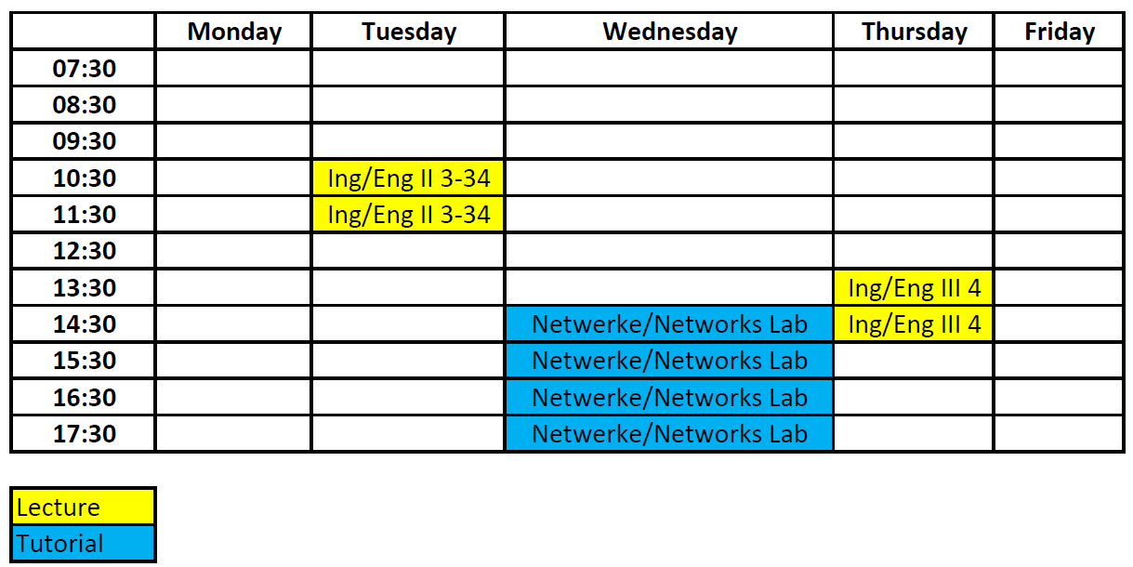
Timetable
For each study unit there will be a typical class test problem as well as a practical assignment.
Both of these will count towards your final semester mark.
There might be some study units that will have multiple sessions, and others that will not have any practical assignments.
There will be no practical assignments due for completion during the semester test week.
You will receive class test problems during the Wednesday practical session and will have to complete it during that session. The practical assignment will be done at home.
You will have six days to complete each practical assignment. Each assignment will be due the next Tuesday.

Slide 4
Class tests problems
Each class test will count a portion towards your final semester mark. The exact amount will be revealed later.
The problems will focus on the work done by Dr. Dabrowski.
Typically the problems will focus on practical applications of the theoretical work done in class.
All the tests will be done via ClickUP, and MUST be completed during the practical session in the assigned labs. You are not allowed to complete them from home.

Slide 5
Practical assignments
The assignments will focus on solving problems that are similar to the test questions. You will however have to solve them through coding
This year we will be using Python as the required platform.
You are not allowed to use Matlab.
For each practical assignment you will have to submit a minimal technical document.
The technical document will be used to grade your practical assignment, thus make sure everything is included and correct in your report.
You can use any word processor to create your practical document.
The sub minimum to pass practical's was increased to 50% this year.

Slide 6
Technical report writing
A technical report aims to describe the
  process
  progress
  results
of any given work, while also giving recommendations, discussions and conclusions of the work done.

Slide 7
Technical report structure
Introduction
Literature study
Problem definition and methodology
Results
Discussion
Conclusion
References

Slide 8
Introduction
Answer three basic questions
  What
  Why
  How
Keep it shorter than ½ a page
Separate into three paragraphs discussing each point above

Slide 9
Results
Give your results in an easy and understandable way.
Standard method for displaying results.
Rather use a table than text.
Rather use a graph than a table.
Python has a wide variety of ways to display your results in graph form.
Make sure to properly label your graph, axis and legends.
Make sure I can read values from the graph!!!
When comparing two types of results, give them in the same graph so that a direct comparison can be seen.

Slide 10
Statistically valid results
Whenever you work with any type of randomized process, repetition is required to validate any results that you obtain.
Repeat any simulation multiple times and take the mean over all the simulations.
You can (usually) never have too many iterations in repeating a simulation. You can however have too few.
If your results are jagged on a graph, more iteration are required.
By running a large amount of simulations, outlier situations can be discovered.

Slide 11
Discussion and Conclusion
ALWAYS discuss the results obtained in full.
Prove that you understand the results.
Discuss the results even if they are incorrect.
The discussion might not be very long, but it is very important.
In the conclusion reference back to the why and the how that was discussed in the introduction.
Give a short review of the results obtained and what significance these results have.

Slide 12
Python
On ClickUP you will find a document that will give you a revision on Python and a point to start at.
Work through the document and make sure you understand the basics behind Python.
Each platform has its own syntax, so expect to struggle a bit in the beginning.
There is a massive online community that use Python. Whenever you get stuck first go and check for the solution online.
The varsity computers use PythonXY as the IDE.
There are some example problems on ClickUP (including answers) that you can work through to make sure you understand the basics of Python.
This session work will not count any marks.

